Slide 1
Chapter 7 Python Collections Lists, Tuples, Sets, and Dictionaries

Slide 2
Opening Problem
Read one hundred numbers, compute their average, and find out how many numbers are above the average.

Slide 3
Objectives
To describe why lists are useful in programming.
To invoke list’s methods.
To use the len, min/max and sum for a list.
To access list elements using indexing operator.
To obtain a sublist using the slicing operator.
To use +, *, and in/not in operators on lists.
To traverse elements in a list using a loop.
To split a string to a list using the str’s split method.
To copy contents from one list to another.
To learn the difference between mutable and immutable data structure.
To use tuples as immutable lists
To use Python dictionaries to store associative data
To store key/value pairs in a dictionary and access value using the key.
To implement algorithms to compute elementary statistics.
To learn how to create frequency table.
To use methods from the Python statistics module
To use sets for storing and fast accessing non-duplicate elements.
To understand the performance differences between sets and lists.

Slide 4
Storing Data for Processing
Anytime that we work with large amounts of data it is necessary to have some means of organized storage so that processing of the data can take place in an orderly and efficient manner.

Slide 5
Data Structures
Data structures are particular ways of storing data to make some operation easier or more efficient. That is, they are tuned for certain tasks
Data structures are suited to solving certain problems, and they are often associated with algorithms.

Slide 6
Kinds of data structures
Roughly two kinds of data structures:
built-in data structures, data structures that are so common as to be provided by default
user-defined data structures (classes in object oriented programming) that are designed for a particular task

Slide 7
Python built in data structures
Python comes with a general set of built in data structures:
string
lists
Tuples
Sets
Dictionaries
others...

Slide 8
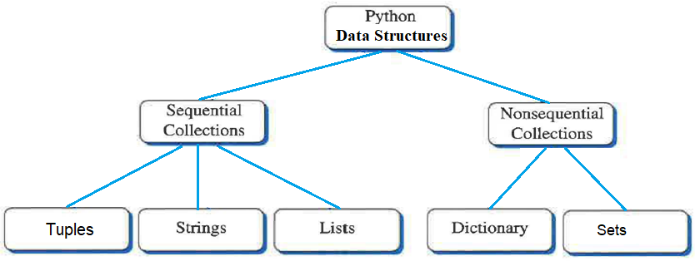
Lists and Strings as Sequential Collections
We will first consider one of Python's built-in collections as a means of storing our data values: lists.

Slide 9
Lists
A list is an ordered, sequential collection of zero or more Python data objects.
Lists are written as comma-delimited values enclosed in square brackets.
We call a list with zero data objects the empty list, which is represented simply by [ ].
Strings are homogeneous collections because each item in the collection is the same type of object-a character. Lists, by contrast, are heterogeneous and can be composed of any kind of object.

Slide 10
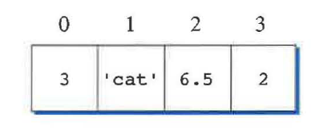
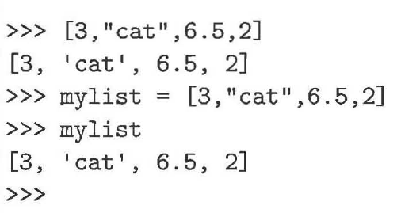
Lists (cont’d.)

Slide 11
Using Sequence Operators with Lists
Since lists are considered to be sequential, they support a number of operations that can be applied to any Python sequence.
These are the same operations that we used with strings since both are composed of a sequential collection of items.

Slide 12
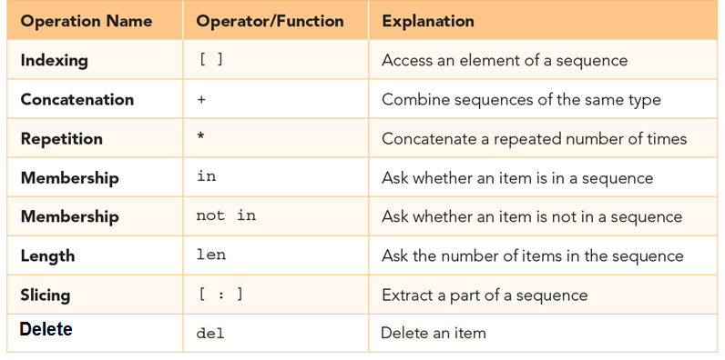
Using Sequence Operators with Lists (cont’d.)

Slide 13
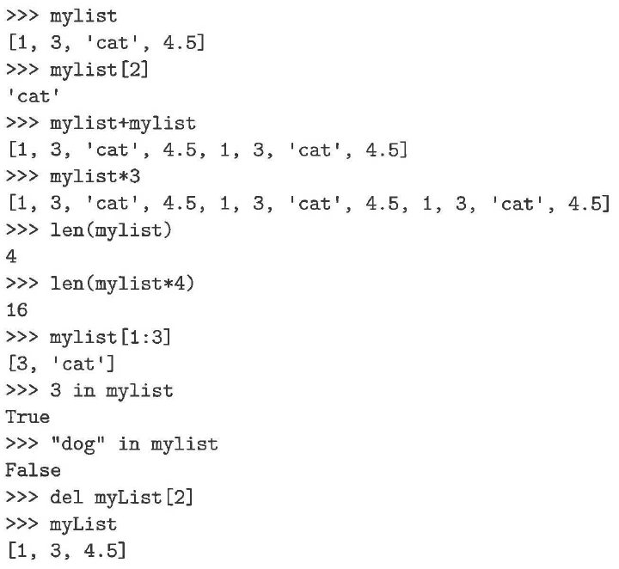
Using Sequence Operators with Lists (cont’d.)

Slide 14
Using Sequence Operators with Lists (cont’d.)
Indices for lists, as with strings, start with 0.
The slice operation mylist [1: 3] returns a list of items starting with the item indexed by 1 up to but not including the item indexed by 3.

Slide 15
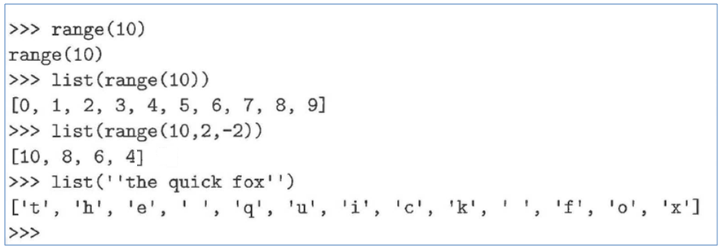
Using the List Function
A useful function for creating lists is the list function.
The list function converts other sequences to lists.
We have seen two such sequences: strings and ranges.

Slide 16
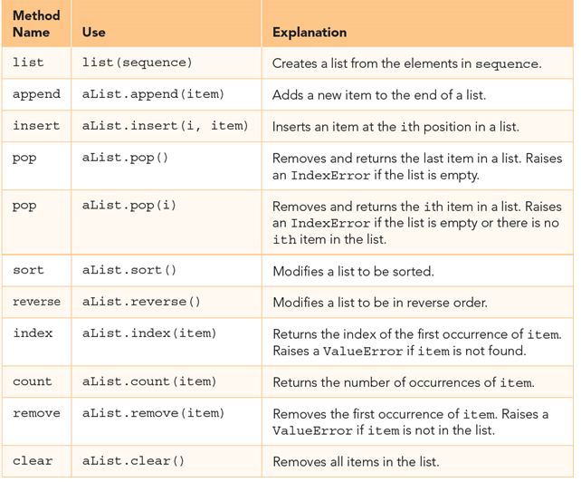
Methods Provided by Lists in Python

Slide 17
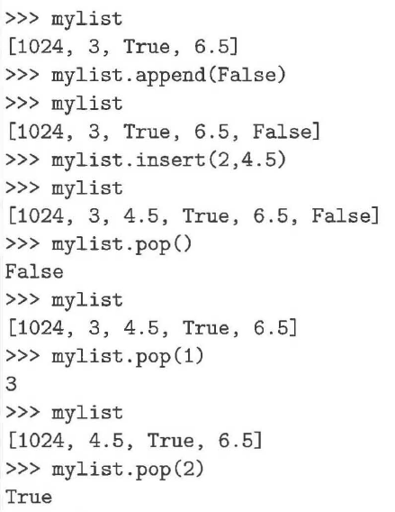
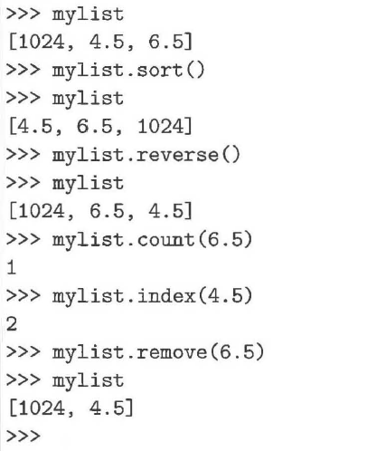
Methods Provided by Lists in Python (cont’d.)

Slide 18
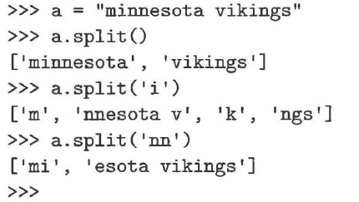
Using the Split Method
split takes a string as a parameter that indicates the places to break the string into substrings.
The substrings are returned in a list.
By default, if no parameter is passed to split, it will break the string using one or more spaces as the delimiter.

Slide 19
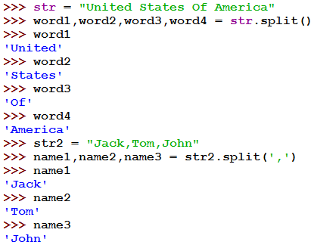

Slide 20
Problem: Analyze Numbers
# Number of elements above the average
NUMBER_OF_ELEMENTS = 5
numbers = [] # Create an empty list
sum = 0
for i in range(NUMBER_OF_ELEMENTS):
value = float(input("Enter a new number: "))
numbers.append(value) # Append value to numbers list
sum += value
average = sum / NUMBER_OF_ELEMENTS
count = 0 # The number of elements above average
for i in range(NUMBER_OF_ELEMENTS):
if numbers[i] > average:
count += 1
print("Average is", average)
print("Number of elements above the average is", count)
Enter a new number: 3
Enter a new number: 6
Enter a new number: 9
Enter a new number: 3
Enter a new number: 4
Average is 5.0
Number of elements above the average is 2

Slide 21
Differences between Lists and Strings
lists can contain a mixture of any python object, strings can only hold characters
lists are mutable, their values can be changed, while strings are immutable
lists are designated with [ ], with elements separated by commas, strings use " " or ' '

Slide 22
Mutating a List
Strings are immutable collections of data where individual items within the string cannot be changed, however, lists are mutable collections of data that can be modified.

Slide 23
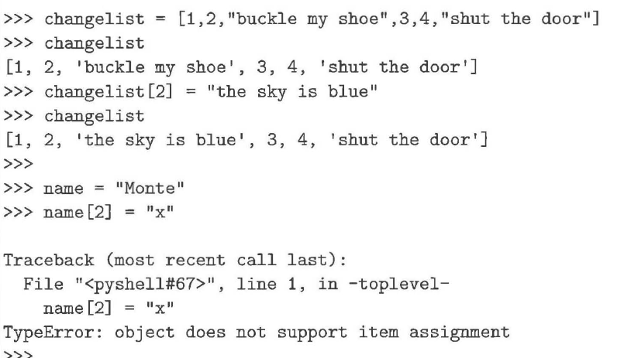
Mutating a List (cont’d.)

Slide 24
Immutable
Assignment takes an object from the RHS and associates it with a variable on the left hand side
When you assign one variable to another, you share the association with the same object
Object sharing, two variables associated with the same object, is not a problem since the object cannot be changed
Any changes that occur generate a new object.

Slide 25
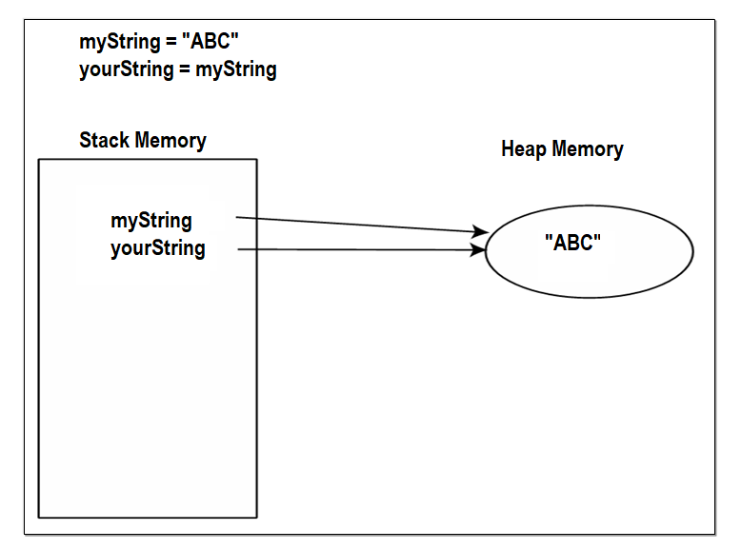
Immutable (cont’d.)

Slide 26
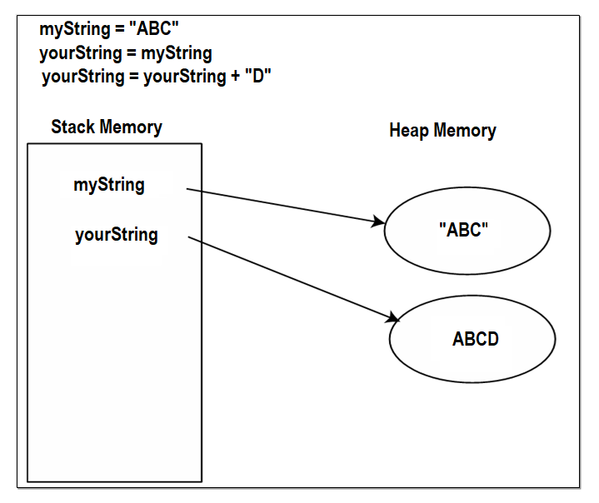
Immutable (cont’d.)

Slide 27
Mutability
If two variables associate with the same object, then both reflect any change to that object

Slide 28
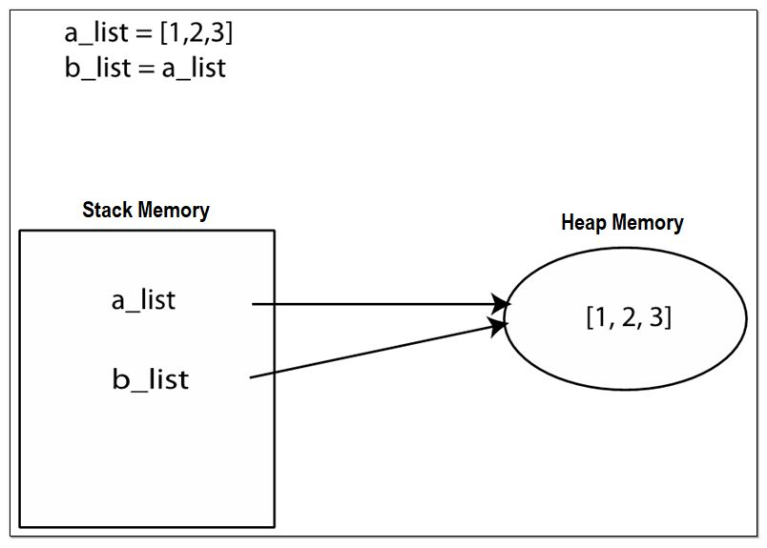
Mutability (cont’d.)

Slide 29
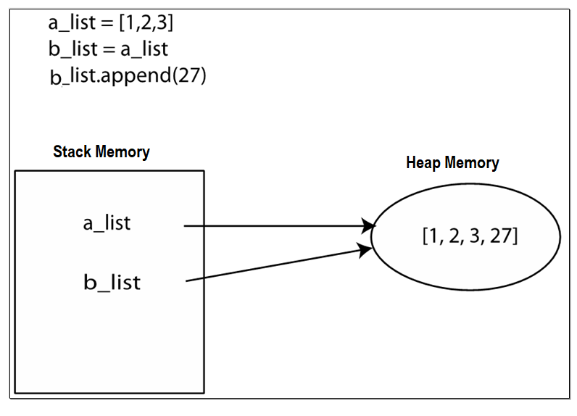
Mutability (cont’d.)

Slide 30
Deep Copy
To copy the data in one list to another list, you have to copy individual elements from the source list to the target list.
my_list = [1, 2, 3]
your_list = []
for element in my_list:
your_list.append(element)
You can use the sclicer.
my_list = [1, 2, 3]
newLst = my_list[:]

Slide 31
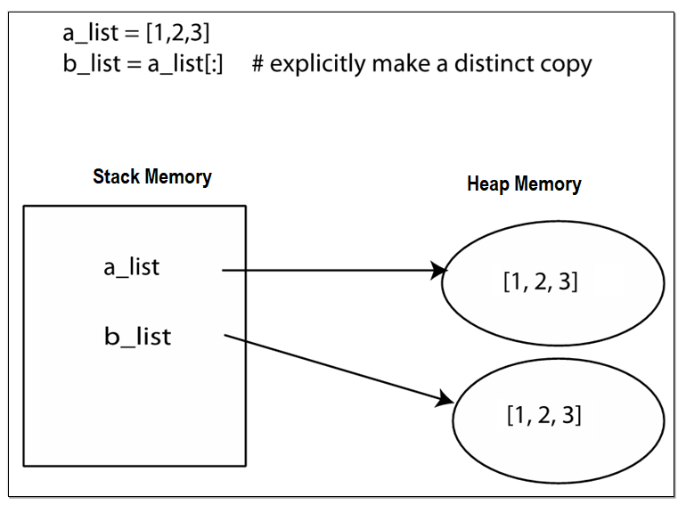
Deep Copy

Slide 32
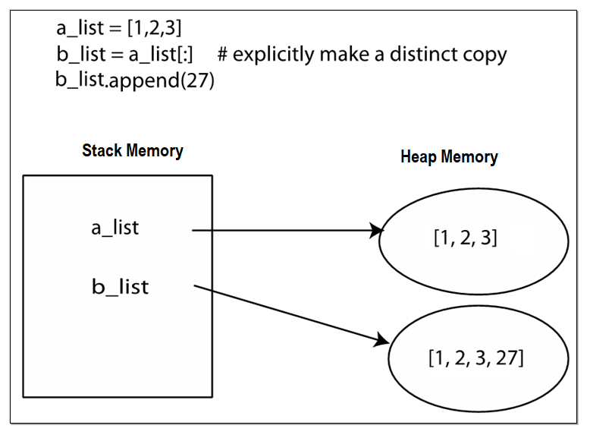
Deep Copy (cont’d.)

Slide 33
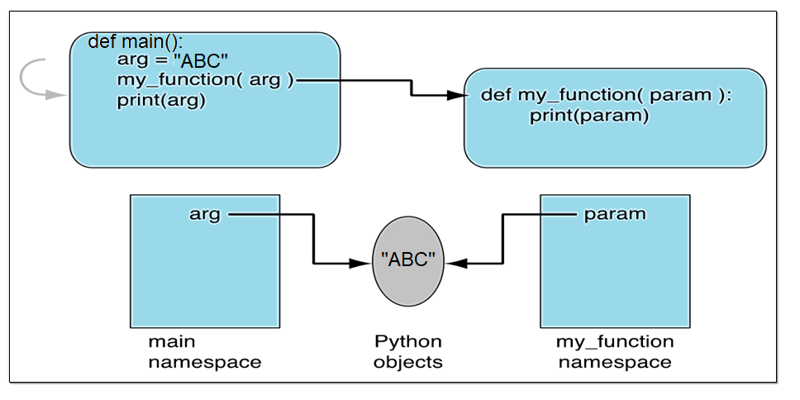
Passing immutable objects

Slide 34
Passing immutable objects (cont’d.)
The diagram should make it clear that the parameter name is local to the function. Passing means that the argument and the parameter, named in two different memories, share an association with the same object.
So “passing” means “sharing” in Python

Slide 35
Passing immutable objects (cont’d.)
If a parameter is assigned to a new value, then just like any other assignment, a new association is created
This assignment does not affect the object associated with the argument, as a new association was made with the parameter

Slide 36
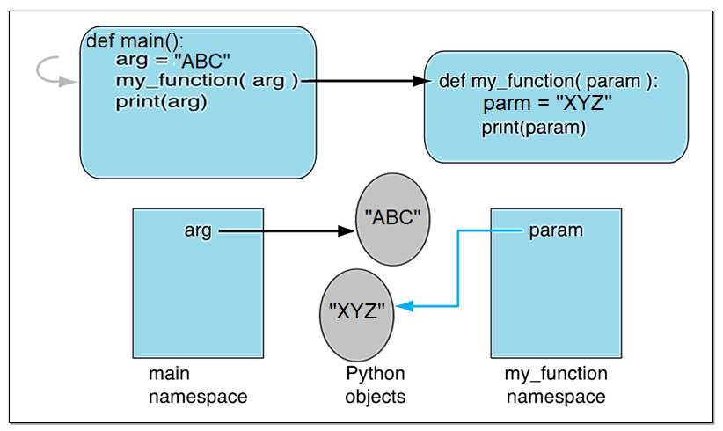
Passing immutable objects (cont’d.)

Slide 37
Passing Mutable Objects
When passing mutable data structures, it is possible that if the shared object is directly modified, both the parameter and the argument reflect that change

Slide 38
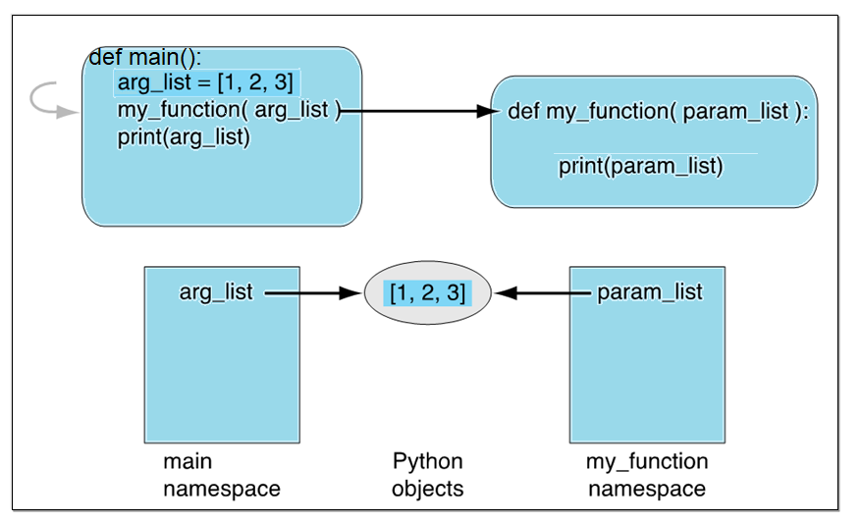
Passing Mutable Objects (cont’d.)

Slide 39
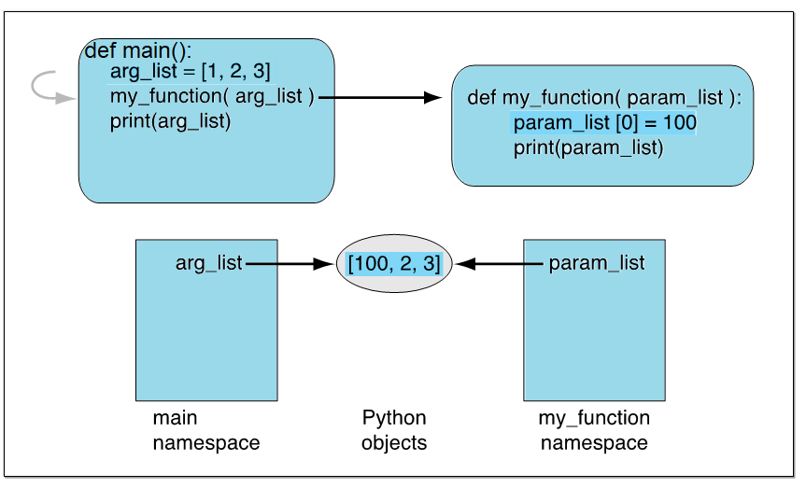
Passing Mutable Objects (cont’d.)

Slide 40
Tuples
Tuples are very similar to lists in that they are heterogeneous sequences of data.
Tuple is immutable, a tuple element cannot be changed.
Tuples are written as comma-delimited values enclosed in parentheses.
As sequences, they can use any of the operations for lists and strings.

Slide 41
Tuples (cont’d.)
The real question is, why have an immutable list, a tuple, as a separate type?
An immutable list gives you a data structure with some integrity.
You know you cannot accidentally change one.

Slide 42
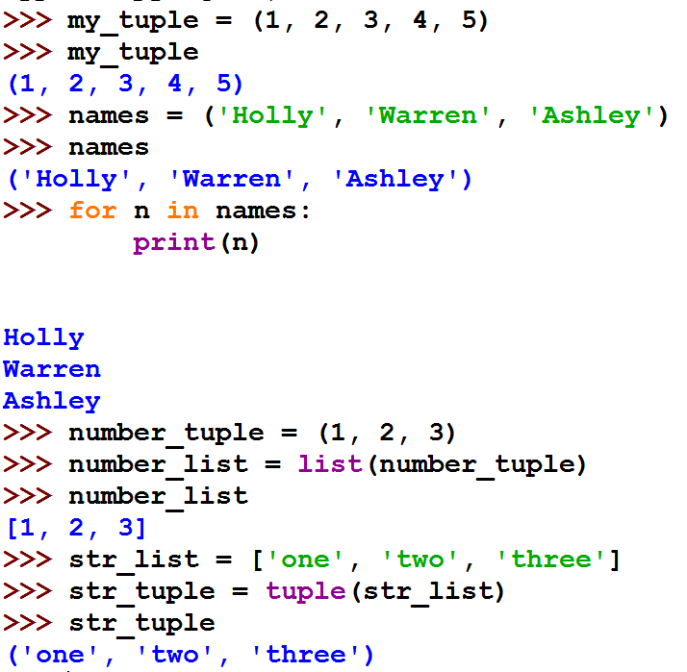

Slide 43
Tuples (cont’d.)
If the only difference between lists and tuples is immutability, you might wonder why tuples exist.
Processing a tuple is faster than processing a list.
Tuples are safe since you are not allowed to change the contents of a tuple.
There are certain operations in Python that require the use of a tuple.

Slide 44
Lists and Tuple
Everything that works with a list works with a tuple except methods that modify the tuple
Thus indexing, slicing, len, print all work as expected
However, none of the mutable methods work: append, insert, remove

Slide 45
Tuple Demo
# Create a tuple
tuple1 = ("green", "red", "blue")
print(tuple1)
# Create a tuple from a list
tuple2 = tuple([7, 1, 2, 23, 4, 5])
print(tuple2)
print("length is", len(tuple2)) # Use len
print("max is", max(tuple2)) # Use max
print("min is", min(tuple2)) # Use min
print("sum is", sum(tuple2)) # Use sum
# Use indexer
print("The first element is", tuple2[0])
# Combine 2 tuples
tuple3 = tuple1 + tuple2
print(tuple3)
# Multiple a tuple
tuple3 = 2 * tuple1
print(tuple3)
# Slicing operator
print(tuple2[2 : 4])
print(tuple1[-1])
print(2 in tuple2) # in operator
for v in tuple1:
print(v, end = " ")
print()
# Obtain a list from a tuple
list1 = list(tuple2)
list1.sort()
tuple4 = tuple(list1)
Print(tuple4)
('green', 'red', 'blue')
(7, 1, 2, 23, 4, 5)
length is 6
max is 23
min is 1
sum is 42
The first element is 7
('green', 'red', 'blue', 7, 1, 2, 23, 4, 5)
('green', 'red', 'blue', 'green', 'red', 'blue')
(2, 23)
blue
True
green red blue
(1, 2, 4, 5, 7, 23)

Slide 46
Statistics in Computer Science
Statistics play an essential role in computer science and vice versa.
Statistics is used for data mining, speech recognition, vision and image analysis, data compression, artificial intelligence, and network and traffic modeling.
A statistical background is essential for understanding algorithms and statistical
properties that form the backbone of computer
science.

Slide 47
What Is Data?
Data (raw data) is a collection of items that have been observed, measured, or collected by some means.
Represents the starting point for analysis that can be done in an attempt to discover underlying characteristics that might be present and are typically referred to as information.
This analysis is based on the mathematical science of statistics.

Slide 48
Simple Dispersion
Dispersion is a measure of how spread out the data values are.
The easiest way to look at dispersion is to consider the range of values and simply compute the difference between the largest and the smallest value in the data set.
Python has built in functions, max and min, that return the maximum and minimum values in the data set.
These functions work with strings as well as with lists since both are examples of sequences.

Slide 49
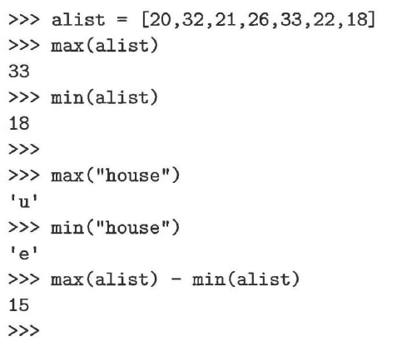

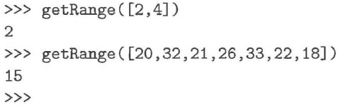
Simple Dispersion (cont’d.)

Slide 50
Maximum\Minimum Value in a List
def getMax(alist):
maxSoFar = alist[0]
for pos in range(1,len(alist)):
if alist[pos] > maxSoFar:
maxSoFar = alist[pos]
return maxSoFar
print("Max:",getMax([3,1,7,6,8,0,2,7]))
print("Max:",getMax([3,1,7,6,7,0,2,8]))
print("Max:",getMax([8,1,7,6,3,0,2,7]))
def getMin(alist):
minSoFar = alist[0]
for pos in range(1,len(alist)):
if alist[pos] < minSoFar:
minSoFar = alist[pos]
return minSoFar
print("Min:",getMin([3,1,7,6,8,0,2,7]))
print("Min:",getMin([3,1,7,6,8,7,2,0]))
print("Min:",getMin([0,1,7,6,8,3,2,7]))
Max: 8
Max: 8
Max: 8
Min: 0
Min: 0
Min: 0
Max: 8
Max: 8
Max: 8

Slide 51
Central Tendency
The central tendency is a process that estimates where the "center" of a collection will be found.
There are three common ways to compute central tendency: (1) mean, (2) median, and (3) mode.

Slide 52

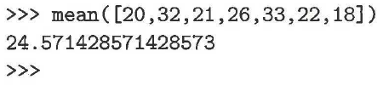
Mean
The most common measure of central tendency is the mean also called the average.
To compute the mean, we simply add up the values in a collection and divide by the number of items.
Python has built in function, sum, that return the sum of values in the data set.

Slide 53
Median
Median, found by locating the item that occurs in the exact middle of a collection.
One way to compute the median is to put the items in order, from lowest to highest, and then find the value that falls in the middle.
If there is an odd number of items, this will be a distinct value.
If there is an even number of items, the average of the two middle values will be used.

Slide 54
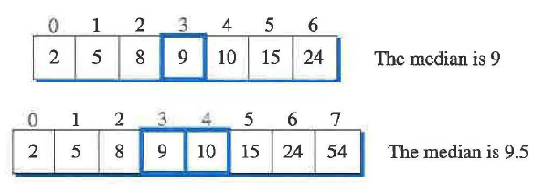
Median (cont’d.)

Slide 55
Median (cont’d.)
The process of ordering values is often referred to as sorting.
Sorting is a very important topic in computer science and there are a number of algorithms that can be used to take a list of data and place them in order.

Slide 56
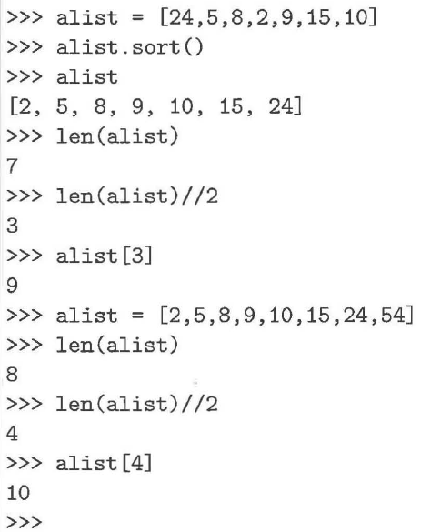
Median (cont’d.)

Slide 57
Median (cont’d.)
def median(alist):
copylist = alist[:] #make a copy using slice operator
copylist.sort()
print(copylist)
if len(copylist)%2 == 0: #even length
rightmid = len(copylist)//2
leftmid = rightmid - 1
median = (copylist[leftmid] + copylist[rightmid])/2.0
else: #odd length
mid = len(copylist)//2
median = copylist[mid]
return median
print("Median:",median([20,32,21,26,33,23,18]))
print("Median:",median([20,32,21,26,33,23,18,29]))
[18, 20, 21, 23, 26, 32, 33]
Median: 23
[18, 20, 21, 23, 26, 29, 32, 33]
Median: 24.5

Slide 58
Median (cont’d.)
Before sorting, we are careful to make a copy of the original list in case the original order is important for later processing.

Slide 59
Mode
The mode of a data set is the most frequently occurring value.
It is possible that there can be more than one mode.
For example, in the list [1,5,2,1,1,6,3,1,5], 1 is the mode since it occurs more than any other value.
However, if the list contained [1,5,2,1,1,5,5,6,3,1,5] , then 1 and 5 would both be considered the mode values since they each occur four times.
In order to compute the mode, we need to process each data item in our list and keep a count of how many times it has occurred thus far.

Slide 60
def mode(alist):
countList =[]
L = []
for element in alist:
if element not in L:
L.append(element)
countList.append(1)
else:
idx = L.index(element)
countList[idx] = countList[idx] + 1
maxCount = max(countList)
idxMaxCount = countList.index(maxCount)
return L[idxMaxCount]
L = [1,5,4,5,4,2,4,7,1,4,6,5]
print ("Mode:",mode(L))
Mode: 4

Slide 61
Mode (cont’d.)
0 | 1 | 2 | 3 | 4 | 5 | 6 | 7 | 8 | 9 | 10 | 11
1 | 5 | 4 | 5 | 4 | 2 | 4 | 7 | 1 | 4 | 6 | 5
alist
0 | 1 | 2 | 3 | 4 | 5
1 | 5 | 4 | 2 | 7 | 6
L
Associate an occurrence count with each individual data value.
0 | 1 | 2 | 3 | 4 | 5
2 | 3 | 4 | 1 | 1 | 1
countList

Slide 62
Mode (cont’d.)
0 | 1 | 2 | 3 | 4 | 5 | 6 | 7 | 8 | 9 | 10 | 11
1 | 5 | 4 | 5 | 4 | 2 | 4 | 7 | 1 | 4 | 6 | 5
alist
L = []
countList = []

Slide 63
Mode (cont’d.)
0 | 1 | 2 | 3 | 4 | 5 | 6 | 7 | 8 | 9 | 10 | 11
1 | 5 | 4 | 5 | 4 | 2 | 4 | 7 | 1 | 4 | 6 | 5
alist
0
1
L
0
1
countList

Slide 64
Mode (cont’d.)
0 | 1 | 2 | 3 | 4 | 5 | 6 | 7 | 8 | 9 | 10 | 11
1 | 5 | 4 | 5 | 4 | 2 | 4 | 7 | 1 | 4 | 6 | 5
alist
0 | 1
1 | 5
L
0 | 1
1 | 1
countList

Slide 65
Mode (cont’d.)
0 | 1 | 2 | 3 | 4 | 5 | 6 | 7 | 8 | 9 | 10 | 11
1 | 5 | 4 | 5 | 4 | 2 | 4 | 7 | 1 | 4 | 6 | 5
alist
0 | 1 | 2
1 | 5 | 4
L
0 | 1 | 2
1 | 1 | 1
countList

Slide 66
Mode (cont’d.)
0 | 1 | 2 | 3 | 4 | 5 | 6 | 7 | 8 | 9 | 10 | 11
1 | 5 | 4 | 5 | 4 | 2 | 4 | 7 | 1 | 4 | 6 | 5
alist
0 | 1 | 2
1 | 5 | 4
L
0 | 1 | 2
1 | 2 | 1
countList

Slide 67
Mode (cont’d.)
0 | 1 | 2 | 3 | 4 | 5 | 6 | 7 | 8 | 9 | 10 | 11
1 | 5 | 4 | 5 | 4 | 2 | 4 | 7 | 1 | 4 | 6 | 5
alist
0 | 1 | 2
1 | 5 | 4
L
0 | 1 | 2
1 | 2 | 2
countList

Slide 68
Mode (cont’d.)
0 | 1 | 2 | 3 | 4 | 5 | 6 | 7 | 8 | 9 | 10 | 11
1 | 5 | 4 | 5 | 4 | 2 | 4 | 7 | 1 | 4 | 6 | 5
alist
0 | 1 | 2 | 3
1 | 5 | 4 | 2
L
0 | 1 | 2 | 3
1 | 2 | 2 | 1
countList

Slide 69
Mode (cont’d.)
0 | 1 | 2 | 3 | 4 | 5 | 6 | 7 | 8 | 9 | 10 | 11
1 | 5 | 4 | 5 | 4 | 2 | 4 | 7 | 1 | 4 | 6 | 5
alist
0 | 1 | 2 | 3
1 | 5 | 4 | 2
L
0 | 1 | 2 | 3
1 | 2 | 3 | 1
countList

Slide 70
Mode (cont’d.)
0 | 1 | 2 | 3 | 4 | 5 | 6 | 7 | 8 | 9 | 10 | 11
1 | 5 | 4 | 5 | 4 | 2 | 4 | 7 | 1 | 4 | 6 | 5
alist
0 | 1 | 2 | 3 | 4
1 | 5 | 4 | 2 | 7
L
0 | 1 | 2 | 3 | 4
1 | 2 | 3 | 1 | 1
countList

Slide 71
Mode (cont’d.)
0 | 1 | 2 | 3 | 4 | 5 | 6 | 7 | 8 | 9 | 10 | 11
1 | 5 | 4 | 5 | 4 | 2 | 4 | 7 | 1 | 4 | 6 | 5
alist
0 | 1 | 2 | 3 | 4
1 | 5 | 4 | 2 | 7
L
0 | 1 | 2 | 3 | 4
2 | 2 | 3 | 1 | 1
countList

Slide 72
Mode (cont’d.)
0 | 1 | 2 | 3 | 4 | 5 | 6 | 7 | 8 | 9 | 10 | 11
1 | 5 | 4 | 5 | 4 | 2 | 4 | 7 | 1 | 4 | 6 | 5
alist
0 | 1 | 2 | 3 | 4
1 | 5 | 4 | 2 | 7
L
0 | 1 | 2 | 3 | 4
2 | 2 | 4 | 1 | 1
countList

Slide 73
Mode (cont’d.)
0 | 1 | 2 | 3 | 4 | 5 | 6 | 7 | 8 | 9 | 10 | 11
1 | 5 | 4 | 5 | 4 | 2 | 4 | 7 | 1 | 4 | 6 | 5
alist
0 | 1 | 2 | 3 | 4 | 5
1 | 5 | 4 | 2 | 7 | 6
L
0 | 1 | 2 | 3 | 4 | 5
2 | 2 | 4 | 1 | 1 | 1
countList

Slide 74
Mode (cont’d.)
0 | 1 | 2 | 3 | 4 | 5 | 6 | 7 | 8 | 9 | 10 | 11
1 | 5 | 4 | 5 | 4 | 2 | 4 | 7 | 1 | 4 | 6 | 5
alist
0 | 1 | 2 | 3 | 4 | 5
1 | 5 | 4 | 2 | 7 | 6
L
0 | 1 | 2 | 3 | 4 | 5
2 | 3 | 4 | 1 | 1 | 1
countList

Slide 75
Mode (cont’d.)
0 | 1 | 2 | 3 | 4 | 5 | 6 | 7 | 8 | 9 | 10 | 11
1 | 5 | 4 | 5 | 4 | 2 | 4 | 7 | 1 | 4 | 6 | 5
alist
0 | 1 | 2 | 3 | 4 | 5
1 | 5 | 4 | 2 | 7 | 6
L
0 | 1 | 2 | 3 | 4 | 5
2 | 3 | 4 | 1 | 1 | 1
countList
Max(countList)

Slide 76
Mode (cont’d.)
0 | 1 | 2 | 3 | 4 | 5 | 6 | 7 | 8 | 9 | 10 | 11
1 | 5 | 4 | 5 | 4 | 2 | 4 | 7 | 1 | 4 | 6 | 5
alist
0 | 1 | 2 | 3 | 4 | 5
1 | 5 | 4 | 2 | 7 | 6
L
0 | 1 | 2 | 3 | 4 | 5
2 | 3 | 4 | 1 | 1 | 1
countList
countList.index(Max(countList))

Slide 77
Mode (cont’d.)
0 | 1 | 2 | 3 | 4 | 5 | 6 | 7 | 8 | 9 | 10 | 11
1 | 5 | 4 | 5 | 4 | 2 | 4 | 7 | 1 | 4 | 6 | 5
alist
0 | 1 | 2 | 3 | 4 | 5
1 | 5 | 4 | 2 | 7 | 6
L
L[countList.index(Max(countList))]
0 | 1 | 2 | 3 | 4 | 5
2 | 3 | 4 | 1 | 1 | 1
countList
countList.index(Max(countList))

Slide 78
Mode (cont’d.)
What if the list has more than one mode?
An easier way to solve the mode problem is to use a collection that associates pairs of items
Python has an associative collection called dictionary.

Slide 79
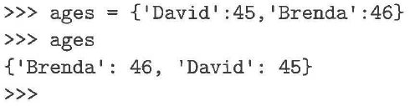
Python Dictionaries
Python dictionaries are collections of associated pairs of items where each pair consists of a key and a value.
In dictionary notation, a key-value pair is written as key:value.
Dictionaries are written as comma-delimited key:value pairs enclosed in curly braces.
The empty dictionary is written as {}.

Slide 80
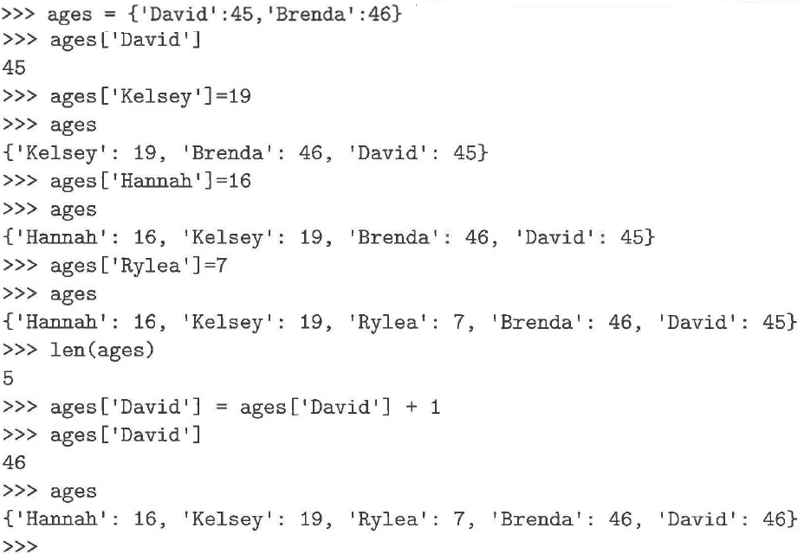
Python Dictionaries (cont’d.)

Slide 81
Python Dictionaries (cont’d.)
To access a value, we use the dictionary key, which may be any object, inside the square bracket index operator.
To add a new key-value pair to the dictionary, we use the index operator with the new key on the left-hand side of the assignment statement and the new value on the right.
Dictionary is maintained in no particular order with respect to the keys.
Dictionaries are mutable, they can be modified.

Slide 82
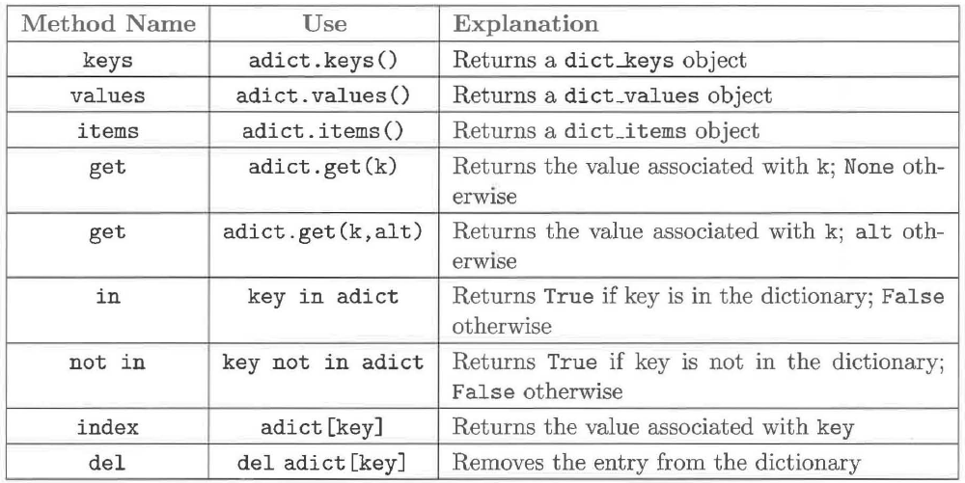
Methods Provided by Dictionaries

Slide 83
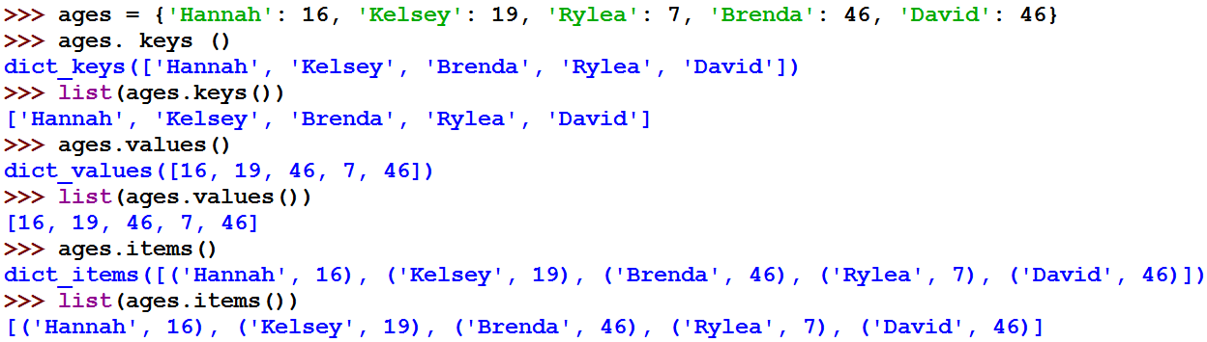
Dictionary Examples

Slide 84
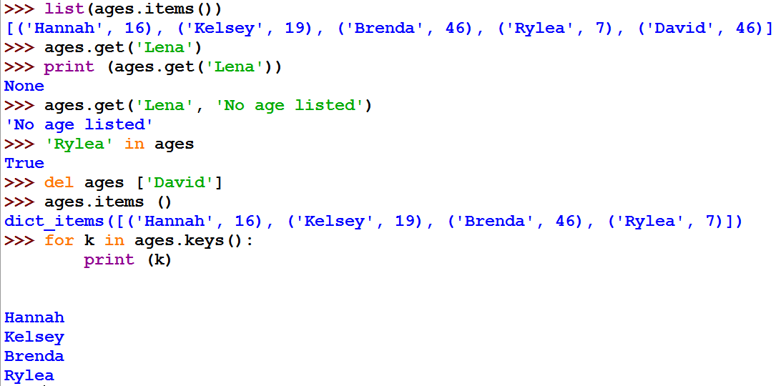
Dictionary Examples (cont’d.)

Slide 85
Building Dictionaries Faster
zip creates pairs from two parallel lists
zip("abc",[1,2,3]) yields
[('a',1),('b',2),('c',3)]
That's good for building dictionaries. We call the dict function which takes a list of pairs to make a dictionary
dict(zip("abc",[1,2,3])) yields
{'a': 1, 'c': 3, 'b': 2}

Slide 86
Computing the Mode
In order to count each occurrence of the data items, we use a dictionary where the key is the data item itself and the associated value is the occurrence count.

Slide 87
Computing the Mode (cont’d.)
def mode(alist):
countDict = {}
for item in alist:
if item in countDict:
countDict[item] = countDict[item]+1
else:
countDict[item] = 1
return countDict
dict = mode([1,5,4,5,4,2,4,7,1,4,6,5])
print("{0:8s}{1:8s}".format("key","value"))
for key, value in dict.items():
s = "{0:<8d}{1:<8d}".format(key,value)
print(s)
key value
1 2
5 3
4 4
2 1
7 1
6 1

Slide 88
Find more than one Mode
def mode(alist):
countDict = {}
for item in alist:
if item in countDict:
countDict[item] = countDict[item]+1
else:
countDict[item] = 1
countlist = countDict.values()
maxcount = max(countlist)
modeList = [ ]
for item in countDict:
if countDict[item] == maxcount:
modeList.append(item)
return modeList
print (mode([9,1,1,2,2,2,4,4,7,7,1,5,6,5]))
print (mode([2,4,7,3,9,8,1,5]))
[1, 2]
[2, 4, 7, 3, 9, 8, 1, 5]

Slide 89
Frequency Distribution
Frequency distribution is a representation of the number of times each value occurs in the data.
One way to display a frequency distribution is to show a two-column table.
The first column gives the data item, and the second gives the associated count.
The table will need to show the items in order.
Dictionary does not maintain any obvious order.
Our challenge is to order the data.

Slide 90
Using a Dictionary to Compute a Frequency Table
Extract the keys.
convert the dict_keys object to a list.
Use the built-in sort method to provide the ordering.
Iterate over the sorted list of keys
Print a table entry consisting of the key and the associated count from the count dictionary.

Slide 91
Using a Dictionary to Compute a Frequency Table (cont’d.)
def frequencyTable(alist):
countdict = {}
for item in alist:
if item in countdict:
countdict[item] = countdict[item]+1
else:
countdict[item] = 1
itemlist = list(countdict.keys())
itemlist.sort()
print("ITEM","FREQUENCY")
for item in itemlist:
print(item, " ",countdict[item]
frequencyTable([3,3,5,7,1,2,5,2,3,4,6,3,4,6,3,4,5,6,6])
ITEM FREQUENCY
1 1
2 2
3 5
4 3
5 3
6 4
7 1

Slide 92
Dispersion: Standard Deviation
Standard deviation is an alternative statistical measure of dispersion.
Shows how much the individual data items of a collection differ from the mean.
The larger the spread of the data around the mean, the larger the standard deviation.
Data that have a small standard deviation are clustered tightly around the mean.
Data that have a large standard deviation are more dispersed.

Slide 93
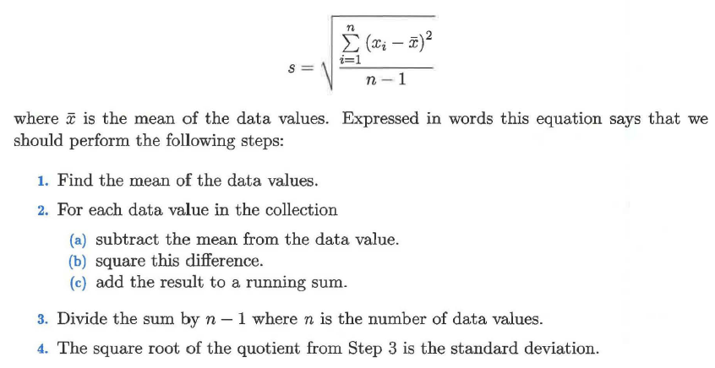
Dispersion: Standard Deviation (cont’d.)

Slide 94
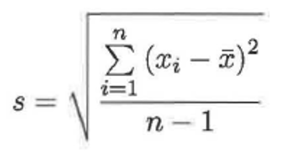
Dispersion: Standard Deviation (cont’d.)
def mean(alist):
mean = sum(alist) / len(alist)
return mean
import math
def standardDev(alist):
theMean = mean(alist)
sum = 0
for item in alist:
difference = item - theMean
diffsq = difference ** 2
sum = sum + diffsq
sdev = math.sqrt(sum/(len(alist)-1))
return sdev
print ("STDV:",standardDev( [2,3,4,5,6,6,7,2,3] ))
STDV: 1.855921454276674

Slide 95
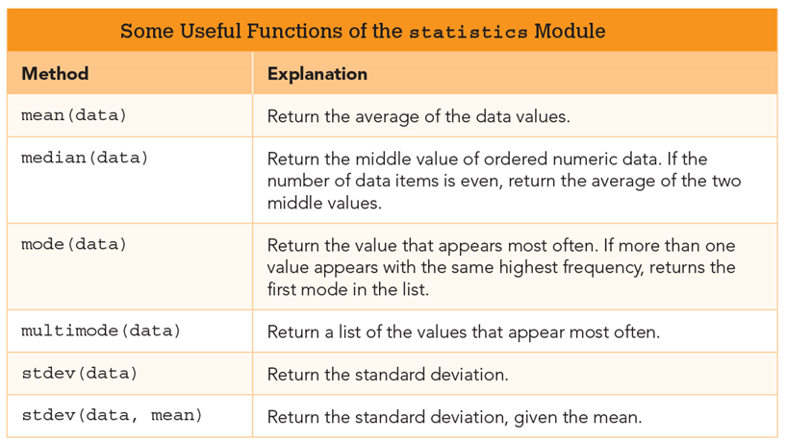
The Statistics Module
Python’s statistics module can help with our analysis of the data. To use these methods, we need to import the statistics module.

Slide 96
Sets, as in Mathematical Sets
In mathematics, a set is a collection of objects, potentially of many different types
In a set, no two elements are identical. That is, a set consists of elements each of which is unique compared to the other elements
There is no order to the elements of a set
A set with no elements is the empty set

Slide 97
Creating a Set
Set can be created in one of two ways:
constructor: set(iterable) where the argument is iterable
my_set = set('abc')
my_set → {'a', 'b','c'}
shortcut: {}, braces where the elements have no colons (to distinguish them from dicts)
my_set = {'a', 'b','c'}

Slide 98
Diverse Elements
A set can consist of a mixture of different types of elements
as long as the single argument can be iterated, you can make a set of it

Slide 99
No Duplicates
duplicates are automatically removed
my_set = set("aabbccdd")
print(my_set)
→ {'a', 'c', 'b', 'd'}

Slide 100
Python Sets Are Mutable
Like lists and dictionaries, sets are mutable data structures.
Though index assignment is not possible on a set (it isn’t a sequence), various methods of the set (such as add or remove) change the elements of a set.

Slide 101
Set Methods
my_set.add("g")
adds to the set, no effect if item is in set already
my_set.clear()
emptys the set
my_set.remove("g") versus my_set.discard("g")
remove throws an error if "g" isn't there.
discard doesn't care.
Both remove "g" from the set
my_set.copy()
returns a copy of my_set

Slide 102
Copy vs. Assignment
my_set=set (['a', 'b', 'c‘])
my_copy = my_set.copy()
my_ref_copy = my_set
my_set.remove('b')
my_set
my_set
set(['a','c'])
set(['a',’b’,'c‘])
myRefCopy
myRefCopy
set(['a','b','c‘])
set(['a','b','c‘])
myCopy
myCopy

Slide 103
Common Operators
Most data structures respond to these:
len(my_set)
the number of elements in a set
element in my_set
boolean indicating whether element is in the set
for element in my_set:
iterate through the elements in my_set

Slide 104
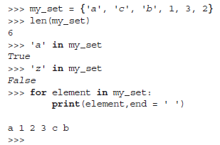
Common Operators (cont’d.)

Slide 105
Set Operators
The set data structure provides some special operators that correspond to the operators you learned in middle school.
These are various combinations of set contents
These operations have both a method name and a shortcut binary operator

Slide 106
Method: Intersection, op: &
a_set=set("abcd") b_set=set("cdef")
a b c d
e f
a_set & b_set → {'c', 'd'}
b_set & a_set → {'c', 'd'}
b_set.intersection(a_set) → {'c', 'd'}

Slide 107
Method: Difference, op: -
a_set=set("abcd") b_set=set("cdef")
a b c d
e f
a_set – b_set → {'a', 'b'}
a_set.difference(b_set) → {‘a', ‘b'}
b_set – a_set → {‘e', ‘f'}
b_set.difference(a_set) → {'e', 'f'}

Slide 108
Method: Union, op: |
a_set=set("abcd") b_set=set("cdef")
a b c d e f
a_set | b_set → {'a', 'b', 'c', 'd', 'e', 'f'}
b_set.union(a_set) → {'a', 'b', 'c', 'd', 'e', 'f'}

Slide 109
Method: Symmetric_Difference, op: ^
a_set=set("abcd") b_set=set("cdef")
a b c d
e f
a_set ^ b_set → {'a', 'b', 'e', 'f'}
b_set.symmetric_difference(a_set) → {'a', 'b', 'e', 'f'}

Slide 110
Method: Issubset, op: <= Method: Issuperset, op: >=
small_set=set("abc") big_set=set("abcdef")
a b c d e f
small_set <= big_set → True
big_set >= small_set → True

Slide 111
Tuple Demo
# Create a set
set1 = {"green", "red", "blue", "red"}
print(set1)
# Create a set from a list
set2 = set([7, 1, 2, 23, 2, 4, 5])
print(set2)
print("Is red in set1?", "red" in set1)
print("length is", len(set2)) # Use len
print("max is", max(set2)) # Use max
print("min is", min(set2)) # Use min
print("sum is", sum(set2)) # Use sum
# Set union
set3 = set1 | {"green", "yellow"}
print(set3)
# Set difference
set3 = set1 - {"green", "yellow"}
print(set3)
# Set intersection
set3 = set1 & {"green", "yellow"}
print(set3)
# Set exclusive or
set3 = set1 ^ {"green", "yellow"}
print(set3)
# Obtain a list from a set
list1 = list(set2)
Print(list1)
set1.add("yellow")
print(set1)
set1.remove("yellow")
print(set1)
{'red', 'green', 'blue'}
{1, 2, 4, 5, 7, 23}
Is red in set1? True
length is 6
max is 23
min is 1
sum is 42
{'green', 'yellow', 'red', 'blue'}
{'red', 'blue'}
{'green'}
{'yellow', 'red', 'blue'}
[1, 2, 4, 5, 7, 23]
{'yellow', 'red', 'green', 'blue'}
{'red', 'green', 'blue'}

Slide 112
Set and List Performance Test
import random
import time
NUMBER_OF_ELEMENTS = 10000
# Create a list
lst = list(range(NUMBER_OF_ELEMENTS))
random.shuffle(lst)
# Create a set from the list
s = set(lst)
# Test if an element is in the set
startTime = time.time() # Get start time
for i in range(NUMBER_OF_ELEMENTS):
i in s
endTime = time.time() # Get end time
runTime = int((endTime - startTime) * 1000) # Get test time
print("To test if", NUMBER_OF_ELEMENTS,
"elements are in the set\n",
"The runtime is", runTime, "milliseconds")
# Test if an element is in the list
startTime = time.time() # Get start time
for i in range(NUMBER_OF_ELEMENTS):
i in lst
endTime = time.time() # Get end time
runTime = int((endTime - startTime) * 1000) # Get test time
print("\nTo test if", NUMBER_OF_ELEMENTS,
"elements are in the list\n",
"The runtime is", runTime, "milliseconds")
To test if 10000 elements are in the set
The runtime is 1 milliseconds
To test if 10000 elements are in the list
The runtime is 1057 milliseconds
To remove 10000 elements from the set
The runtime is 1 milliseconds
To remove 10000 elements from the list
The runtime is 501 milliseconds
# Remove elements from a set one at a time
startTime = time.time() # Get start time
for i in range(NUMBER_OF_ELEMENTS):
s.remove(i)
endTime = time.time() # Get end time
runTime = int((endTime - startTime) * 1000) # Get test time
print("\nTo remove", NUMBER_OF_ELEMENTS,
"elements from the set\n",
"The runtime is", runTime, "milliseconds")
# Remove elements from a list one at a time
startTime = time.time() # Get start time
for i in range(NUMBER_OF_ELEMENTS):
lst.remove(i)
endTime = time.time() # Get end time
runTime = int((endTime - startTime) * 1000) # Get test time
print("\nTo remove", NUMBER_OF_ELEMENTS,
"elements from the list\n",
"The runtime is", runTime, "milliseconds")

